Slide 1
Leadership Principles Toward Effective AI Product Development
Shane Lewin

Slide 2
What will we cover today
In AI, there is a large difference between a high performing team and a low performing team.
High performing teams all look the same. Low performing teams come in two flavors.
Four leadership practices of high performing teams that can be easily adopted
If you take only one thing from this talk …
Notes:
Today we are going to talk about 4 practices that you, as a leader in a company with an AI powered product, that you can implement. And that if you do, it will give you a much higher chance of success in the market.
This is based on the experience of about 30 companies spanning the space of applications in AI.
Some were highly successful, with very lean teams making month over month gains and measurable improvement to customer value.
Some were not. 30 person data science teams making very little progress.
In two cases,
AI is a technical space, and if

Slide 3
A few words about myself
Shipped the NLP engine that generates all the summaries you see as a Product Management Lead at Bing
Worked on personalized targeting and engagement as a Manager in Data Science and Engineering at Netflix
Worked on structuring health data from dozens of systems and EMRs as Director of Engineering at Glimpse. (now Apple)
Built a platform to identify high risk patients for select chronic conditions as the VP of Product and Data Science at Lumiata
Am working conversation agents and digital assistants as a Principal in the AI group at Microsoft.
I hold dual BS degrees in Math and Molecular Biology at from the University of Colorado, and an MS in Mathematical Engineering from Stanford University.
As consultant I’ve worked on search engines, conversation agents, predictive analytics, personalized shopping experiences, and self learning data platforms.

Slide 4
4 Practices toward a successful AI-Powered Product
Don’t outsource your product strategy
Data before models (algorithms)
Have a cold-start strategy
Approach agility differently
Notes:
Powerset and Document Summaries
* How did a 30 person team

Slide 5
1. Don’t delegate your product strategy
Notes:
Optimization versus metrics
Google and bing are optimized to put the most relevant result for a query in position 1.

Slide 6
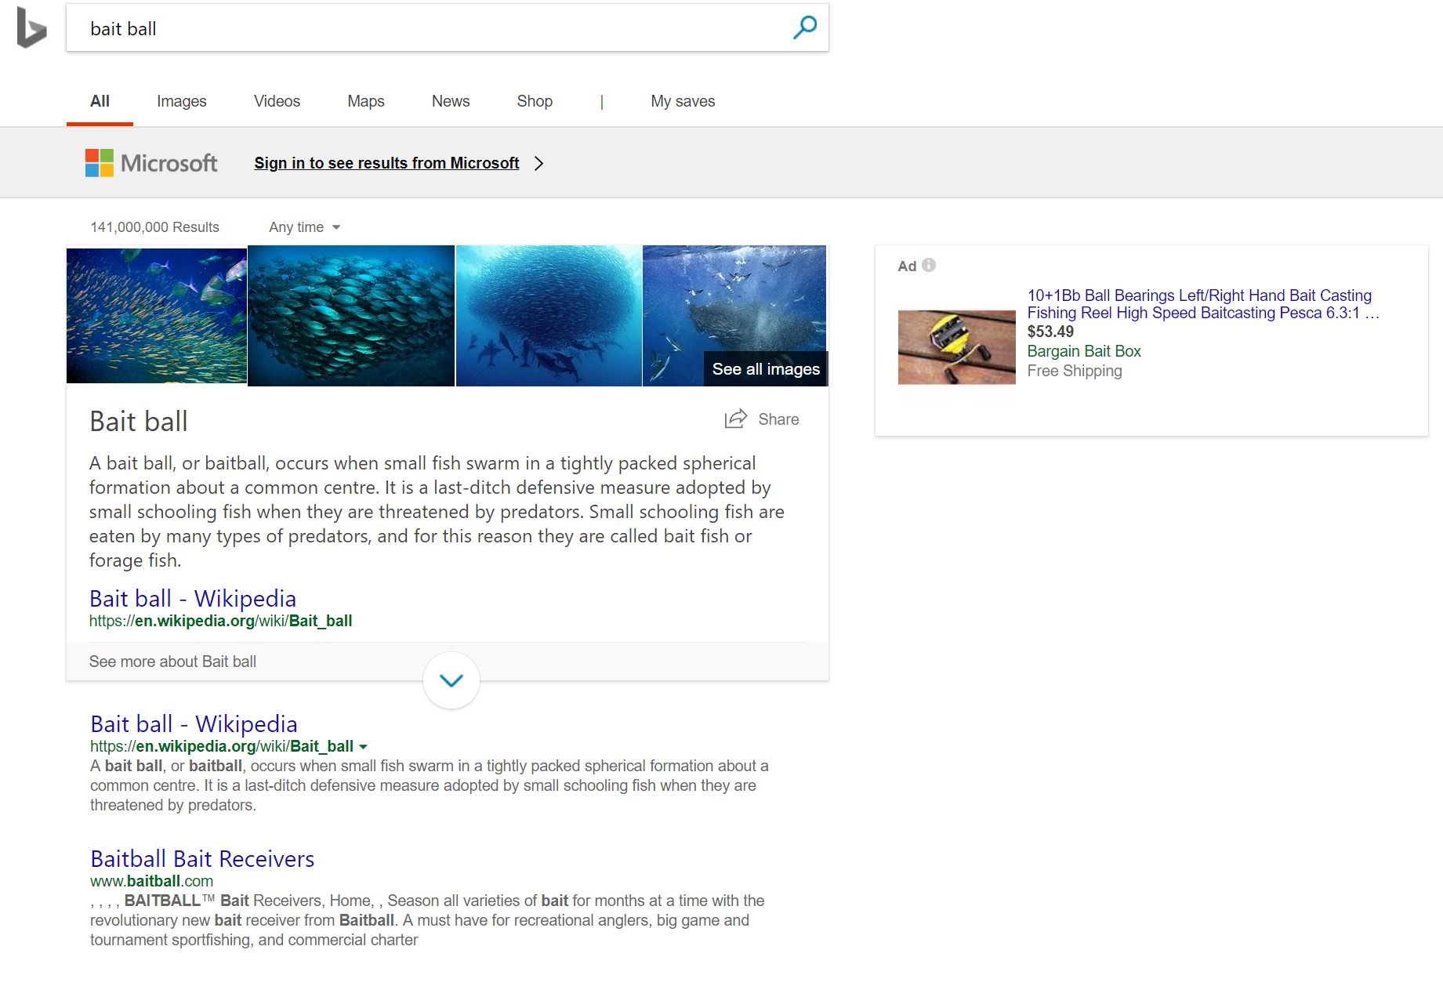
Optimization versus metrics
Optimization describes conceptually what your AI backend is trying to make better.
Metrics quantify the optimization
Ex: Search

Slide 8











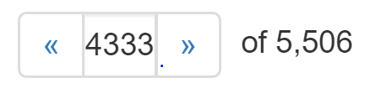
Notes:
* How stock

Slide 9
Some notes about Optimizations
Its very hard to change an optimization once you are live
What you optimize is a part of product strategy
Don’t delegate it!
You don’t learn an optimization from data, but from your customers and their pain points.
Dedicate time to finding it before you start writing software!
Notes:
Start with a 'People Problem’
A people problem is solution agnostic -- it should not be described as using a technology or a product; rather, it is customer problem centric. An example of a people problem might be "it takes too damn long to book al the meetings I have to book. I don’t want to do it any more".
Gather what we know about the problem to size it
You need to size the problem to know not just if you should build it and how robust your solution should be. This is as important in product development as metrics development: a small feature does not call for a massive, expensive metric.
Establish XO's (product hypothesis)
Experience Outcomes (XO's) are a series of product outcomes that we believe will improve the problem defined in step 1. The key question to ask: is if you improved the people problem in step 1, what would you observe? For example, if we solved the meeting problem proposed in (1) we might observe that (1) the total number of minutes for cortana users spent booking meetings would decrease significantly.
Establish metrics / KPI's and/or build evaluation data sets
Metrics are tailored to the output of step 3. They should have baselines (how much time does a median professional spend on a calendar per week) and targets (lets reduce that number by 15%), as well as a measurement strategy. This is a full time job.
Build and iterate on products until the KPI's in step 4 are met.
Track results, observe performance, build, test, evaluate. Ship when good. For example, we might ship when the calendar product takes less time than not using cortana, with a fail rate of less than 5%.

Slide 10
A tale of two Optimizations: Identifying high risk patients
1. For a patient, find all of the conditions she is at risk for
2. Minimize the number of medical records a care manager has to sort through to find a patient at risk for a specific condition.
Notes:
A lot of thiem

Slide 11
Examples
Market | Optimization 1 | Ramifications | Optimization 2 | Market
Stock Photography | Maximize the likelihood of download | Results in higher quality images up top, but for customers who don’t want the most common styles (stocky), it can lead to very long search processes. | Minimize the number of actions to get to 50 candidate images. | Can lead to a a mix of lower quality images. Not as great for the
Identification of high risk patients | Takes a Patient, and return the list of conditions that the patient is at risk for | Fits well into physician workflows where physicians are viewing one patient at a time | Take a list of patients and ranks them in order of risk for a specific condition | Fits well into care manager and payer workflows.
AI Patient Triage | Route patients in a triage setting to the right doctor. | More value long term, (you could automate the triage nurse), but order of magnitude more challenging to build and sell. Significant regulatory concerns. | Eliminate patients that have very low risk and route remaining patients to | Less value long term, but immediate short term value. Much easier to sell, lower regulatory concerns.
Digital Assistant

Slide 12
Takeaway
An optimization is a very clear, customer centric definition of what the AI does
  Not: “Book travel reservations for professionals”
  Yes: “Find the best hotel in 4 actions or less”
What you chose to optimize is a big part of your product strategy.
  Don’t outsource it!
Before you start building anything, use the optimization to build metric.
Notes:
Start with a 'People Problem’
A people problem is solution agnostic -- it should not be described as using a technology or a product; rather, it is customer problem centric. An example of a people problem might be "it takes too damn long to book al the meetings I have to book. I don’t want to do it any more".
Gather what we know about the problem to size it
You need to size the problem to know not just if you should build it and how robust your solution should be. This is as important in product development as metrics development: a small feature does not call for a massive, expensive metric.
Establish XO's (product hypothesis)
Experience Outcomes (XO's) are a series of product outcomes that we believe will improve the problem defined in step 1. The key question to ask: is if you improved the people problem in step 1, what would you observe? For example, if we solved the meeting problem proposed in (1) we might observe that (1) the total number of minutes for cortana users spent booking meetings would decrease significantly.
Establish metrics / KPI's and/or build evaluation data sets
Metrics are tailored to the output of step 3. They should have baselines (how much time does a median professional spend on a calendar per week) and targets (lets reduce that number by 15%), as well as a measurement strategy. This is a full time job.
Build and iterate on products until the KPI's in step 4 are met.
Track results, observe performance, build, test, evaluate. Ship when good. For example, we might ship when the calendar product takes less time than not using cortana, with a fail rate of less than 5%.

Slide 13

2. Data Before Models
(invest in your data infrastructure before your algorithms)

Slide 14
Some things to know once you start developing
Rate of development is more important than algorithms
Feedback makes you defensible
AI is often a winner takes all market
Notes:
Start with a 'People Problem’
A people problem is solution agnostic -- it should not be described as using a technology or a product; rather, it is customer problem centric. An example of a people problem might be "it takes too damn long to book al the meetings I have to book. I don’t want to do it any more".
Gather what we know about the problem to size it
You need to size the problem to know not just if you should build it and how robust your solution should be. This is as important in product development as metrics development: a small feature does not call for a massive, expensive metric.
Establish XO's (product hypothesis)
Experience Outcomes (XO's) are a series of product outcomes that we believe will improve the problem defined in step 1. The key question to ask: is if you improved the people problem in step 1, what would you observe? For example, if we solved the meeting problem proposed in (1) we might observe that (1) the total number of minutes for cortana users spent booking meetings would decrease significantly.
Establish metrics / KPI's and/or build evaluation data sets
Metrics are tailored to the output of step 3. They should have baselines (how much time does a median professional spend on a calendar per week) and targets (lets reduce that number by 15%), as well as a measurement strategy. This is a full time job.
Build and iterate on products until the KPI's in step 4 are met.
Track results, observe performance, build, test, evaluate. Ship when good. For example, we might ship when the calendar product takes less time than not using cortana, with a fail rate of less than 5%.

Slide 16
A Day in the life of a data scientist
Before
After
Go to the cluster, pull down data set
Clean, transform, and normalize the data
Run metrics scripts to label data
Find bugs, clean data again
Split the data into train, test, evaluate
Build models
Evaluate Models
Normalize to compare models to other data sets
Download data sets
Build models
Evaluate models
Notes:
A lot of thiem

Slide 17
Simplified Data Workflow

Slide 18
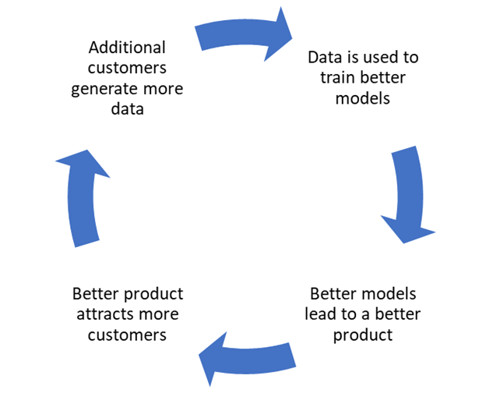
Feedback and the Product Iteration Cycle
Works if your product is structured so that the output of a successful user session leads to the more training data
Sometimes this is called online learning (but not necessarily)
Leads to winner-takes-all markets

Slide 19
Takeaway
Investments in data infrastructure have higher returns early on than investments in data science
Focus on data pipelines before worrying about the model quality
Feedback pipelines allow you to accelerate improvement, and leads to winner takes all markets
Notes:
Start with a 'People Problem’
A people problem is solution agnostic -- it should not be described as using a technology or a product; rather, it is customer problem centric. An example of a people problem might be "it takes too damn long to book al the meetings I have to book. I don’t want to do it any more".
Gather what we know about the problem to size it
You need to size the problem to know not just if you should build it and how robust your solution should be. This is as important in product development as metrics development: a small feature does not call for a massive, expensive metric.
Establish XO's (product hypothesis)
Experience Outcomes (XO's) are a series of product outcomes that we believe will improve the problem defined in step 1. The key question to ask: is if you improved the people problem in step 1, what would you observe? For example, if we solved the meeting problem proposed in (1) we might observe that (1) the total number of minutes for cortana users spent booking meetings would decrease significantly.
Establish metrics / KPI's and/or build evaluation data sets
Metrics are tailored to the output of step 3. They should have baselines (how much time does a median professional spend on a calendar per week) and targets (lets reduce that number by 15%), as well as a measurement strategy. This is a full time job.
Build and iterate on products until the KPI's in step 4 are met.
Track results, observe performance, build, test, evaluate. Ship when good. For example, we might ship when the calendar product takes less time than not using cortana, with a fail rate of less than 5%.

Slide 20

3. Have a cold-start strategy
Notes:
If you’ve been doing

Slide 21
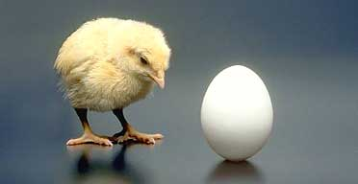

Slide 22
Strategies to overcome cold-starting
Use it yourself
Paid Annotators (harder than you think)
Integrate the AI with Humans
  Sometimes called Wizard of OZ approaches
Notes:
Remember, the goal is to get to the point that people are using the product.

Slide 23
Example: AI Customer Service Agent
Need to perform any action available on the website
Optimization: Get to the same outcome as a real customer service agent in the same or less number of steps
Cold Start strategy: run models in parallel with a human customer service agent. Have the CS agent score the algorithm outputs after each session.
Lagging Metric: Turing Test
Notes:
Remember, the goal is to get to the point that people are using the product.

Slide 24
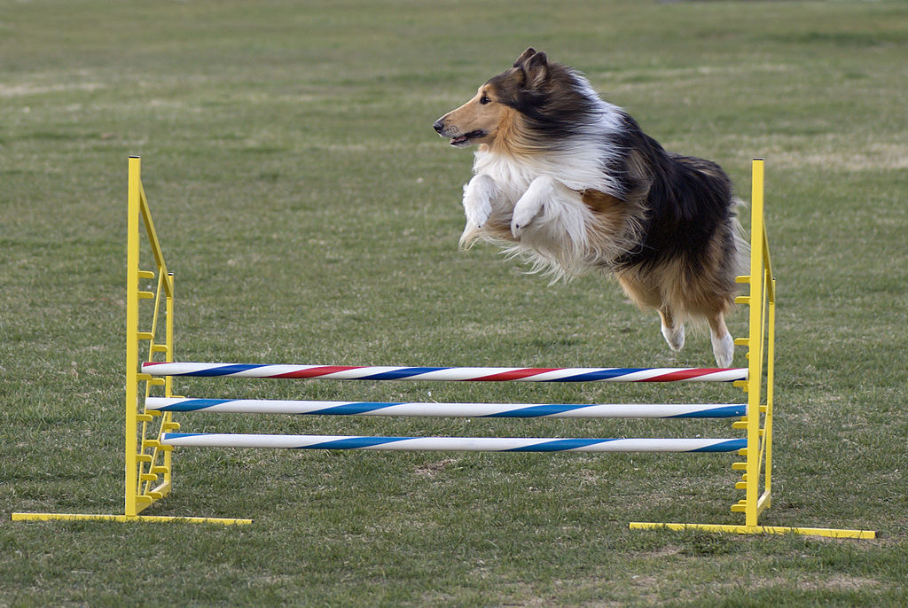
4. On Agility
Notes:
If you’ve been doing

Slide 25
On Agility
It takes a long time to make an AI product viable
IN the early stages, you wont know if your product is poor, or if you have poor PMF
  It is really easy to spend millions on a product that wont get traction!
Mediation: Prototype without models
Notes:
Powerset and Document Summaries
* How did a 30 person team

Slide 26
Quick Review
Don’t delegate your product strategy (metrics before models)
Invest in infrastructure first (data before models)
Have a cold-start strategy
Find PMF before building huge AI systems
Notes:
Powerset and Document Summaries
* How did a 30 person team

Slide 27

Thank you!
Questions?
Notes:
If you’ve been doing

